Slide 1
EXECUTIVE PERFORMANCE REPORT
Healthcare Operations & Financial Analytics
Data-driven insights across clinical performance, patient volume, financial revenue, and facility operations.
ENTERPRISE METRICS 20 Facilities | $9.3B Revenue
VOLUME SCOPE 4.4K Patients | 5.0K Appointments

Slide 2
Enterprise Scale & KPI Summary
Key high-level metrics across overall hospital system operational performance.
$9.3B
4.4K
20
350
Total Revenue
Total Patients
Total Facilities
Total Doctors

Slide 3

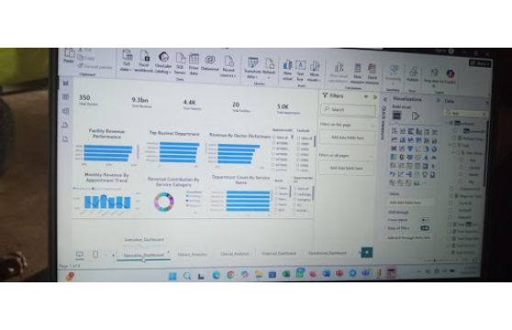
Executive Dashboard Overview
System-wide distribution of departments, patient revenue, and facility performance.
5.0K Total Departments
Structured network managing multi-specialty healthcare services.
Top Busiest Department
Cardiology and Radiology lead in total appointment volume and intake.
Revenue Contribution
Balanced revenue mix across emergency, outpatient, and specialized consultation.

Slide 4
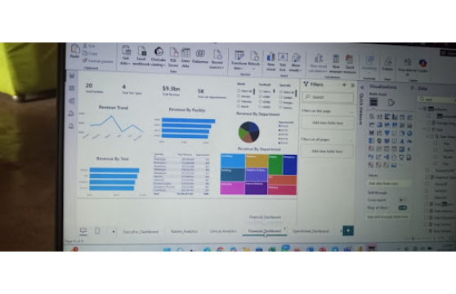
Financial Performance & Revenue Drivers
Analysis of $9.3B total revenue distribution across specialties and diagnostic tests.
Specialty Revenue Leader
Radiology generates top financial yield ($82.0M), followed by Pharmacist services ($72.4M).
Volume Benchmark
5,000 total lab appointments completed across all 20 active facility units.
Testing Portfolio
4 key diagnostic test types drive consistent recurring operational revenue.

Slide 5
Revenue by Medical Specialty ($M)
Comparative financial contribution of core diagnostic and surgical specialties.
Radiologist
$82.0M
Pharmacist
$72.4M
Pediatrician
$71.5M
Pathologist
$70.5M
Obstetrician / Gynecologist
$70.3M

Slide 6
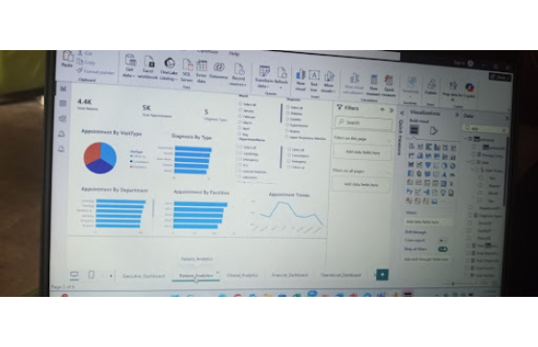
Patient Analytics & Demographics
Appointment behavior, visit types, and department intake volume.
Visit Types Distribution
Balanced proportions across Follow-up, Consultation, and Emergency visits.
Diagnosis Categorization
5 primary diagnosis types tracked across all patient admissions.
Facility Capacity
Consistent appointment distribution across regional hospital facilities.

Slide 7
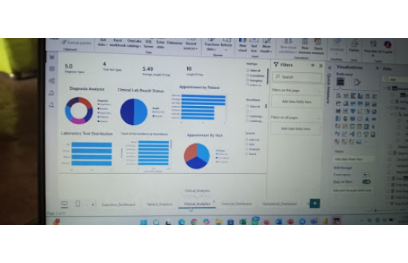
Clinical Analytics & Inpatient Metrics
Clinical lab efficiency, length of stay, and diagnosis analysis.
Inpatient Efficiency
5.49 Days
Average Length of Stay across clinical departments.
Lab Operational Output
10 Days
Maximum recorded length of stay in intensive care units.

Slide 8
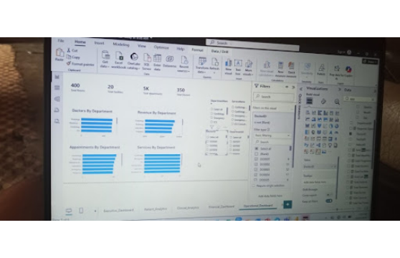
Operational Dashboard & Resource Metrics
Doctor allocation, room occupancy, and service utilization across facilities.
400 Total Rooms
Managed room inventory across all 20 hospital facilities.
350 Total Doctors
Active medical personnel distributed by specialty and department.
Department Volume
Radiology and Cardiology maintain highest physician density.

Slide 9



Key Recommendations
Strategic initiatives to optimize patient throughput and facility revenue.
Reduce Length of Stay
Expand High-Yield Testing
Rebalance Physician Load
Target reduction of ALOS from 5.49 to under 4.8 days for routine consultations.
Scale radiology and lab capacities to meet high diagnostic service demand.
Reallocate 350 doctors across facilities to alleviate high-volume department bottlenecks.

Slide 10
SUMMARY & NEXT STEPS
Driving Value Through Data-Driven Healthcare
Continuous operational reporting empowers healthcare leadership to optimize clinical outcomes and financial growth.
Power BI Analytics System Deployment

